Slide 1
Unit 2 Document Object Model in JavaScript

Slide 2
Syllabus content
Document Object Model
Programming HTML DOM with JavaScript
Assigning event handlers in JavaScript using DOM object property
addeventlistener and removeeventlistener in JavaScript
Event bubbling in JavaScript
Image gallery with thumbnails in JavaScript

Slide 3

1. Document Object Model
Explain the DOM as a programming.
When a web page is loaded
the browser creates a DOM of the page.
It is a standard
object model &
programming interface for HTML
We can use JavaScript to access HTML elements.

Slide 4
2. Programming HTML DOM with JavaScript
JavaScript HTML DOM Document
Finding HTML Elements
Changing HTML Elements
Adding and Deleting Elements
Finding HTML Elements
Method | Description
document.getElementById(id) | Find an element by element id
document.getElementsByTagName(name) | Find elements by tag name
document.getElementsByClassName(name) | Find elements by class name

Slide 5
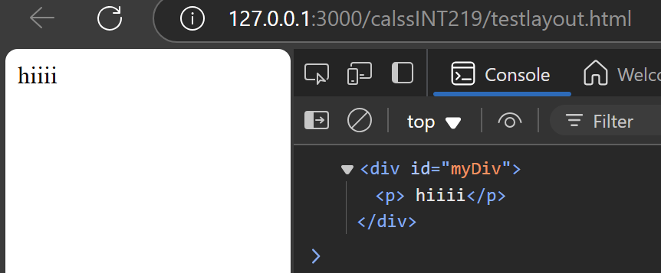
2.1.1 getElementById
Accessing Elements: document.getElementById('elementId’)
Show how to select a single element by its ID.
// HTML: <div id="myDiv"> <p> hiiii</p></div>
const myDiv = document.getElementById('myDiv'); console.log(myDiv);
// Output: <div id="myDiv"> <p> hiiii</p></div>

Slide 6
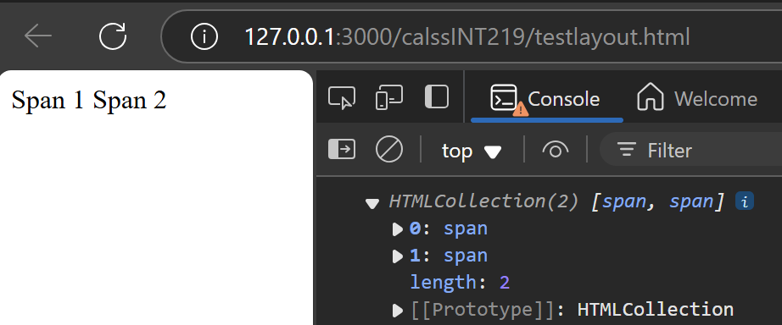
2.1.2 getElementsByTagName
document.getElementsByTagName('tagName'): Show selecting elements by their tag name (returns an HTMLCollection).
// HTML: <span>Span 1</span> <span>Span 2</span>
const mySpans = document.getElementsByTagName('span'); console.log(mySpans);
// Output: HTMLCollection [span, span]

Slide 7
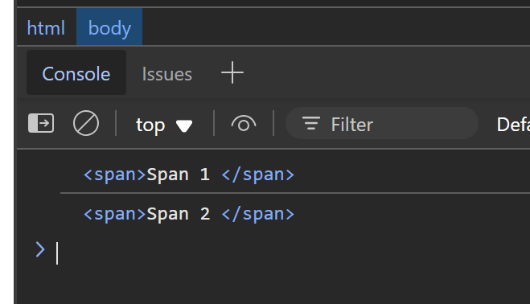
Demonstration
<html> <body>
<span>Span 1 </span> <span>Span 2 </span>
<div id="myDiv">hii</div> </body>
<script>
const mySpans = document.getElementsByTagName('span');
console.log(mySpans[0]); console.log(mySpans[1]);
</script>
</html>

Slide 8
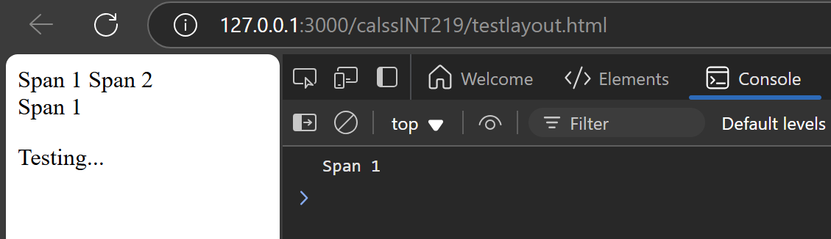
Demo 2
<html> <body>
<span>Span 1</span><span id="x">Span 2</span><div>hii</div> <p class="c"></p></body>
<script>
const mySpans = document.getElementsByTagName('span');
txt=document.getElementById('x').innerText;
console.log(txt);
document.getElementsByTagName("div")[0].innerHTML=txt;
document.getElementsByClassName("c")[0].innerHTML="Testing...";
</script>
</html>

Slide 9
HTML <span>
The HTML <span> tag is an inline container.
Used to group and apply styles or scripts to specific parts of text or elements.
While it doesn’t affect the layout or appearance on its own.
It serves as a target for CSS styling and JavaScript interactions.
<span class="">Some Text</span> <span class="">Some Text</span>

Slide 10
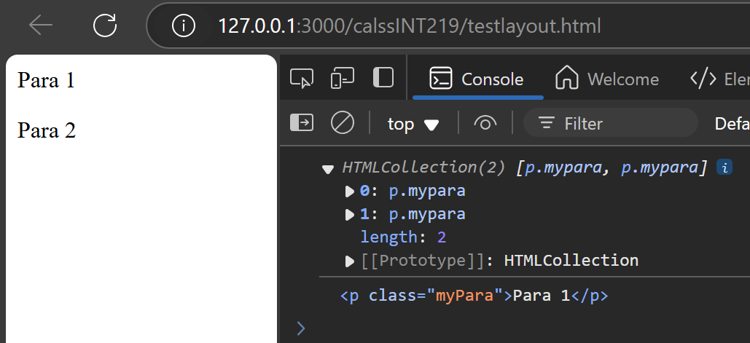
2.1.3 getElementsByClassName
document.getElementsByClassName('className’)
Demonstrate selecting multiple elements by class name
returns an HTMLCollection.
// HTML: <p class="myPara">Para 1</p> <p class="myPara">Para 2</p>
const myParas = document.getElementsByClassName('myPara'); console.log(myParas); // Output: HTMLCollection [p.myPara, p.myPara] console.log(myParas[0]) //Output: <p class="myPara">Para 1</p>

Slide 11
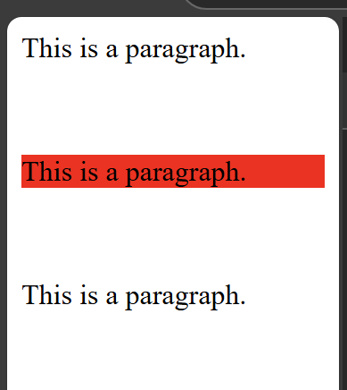
Demo
<html> <body>
<div class="a"> <p>This is a paragraph.</p> </div> <br>
<div class="b"> <p>This is a paragraph.</p> </div> <br>
<div class="b"> <p>This is a paragraph.</p> </div>
<script> const collection = document.getElementsByClassName("b");
collection[0].style.backgroundColor = "red"; </script>
</body>
</html>

Slide 12
Id vs class
The id attribute uniquely identifies a single element.
The class attribute can be applied to multiple elements.
Both are essential for CSS styling and JavaScript manipulation.
Uniqueness: Each ID must be distinct within an HTML page.
Impact on styling: When using CSS to target elements with IDs, only the first element with that ID will be affected if multiple elements have the same ID.
JavaScript issues: In JavaScript, using document.getElementById() to access an element by its ID will only return the first element matching that ID, potentially causing unexpected behavior if you intend to interact with multiple elements.

Slide 13
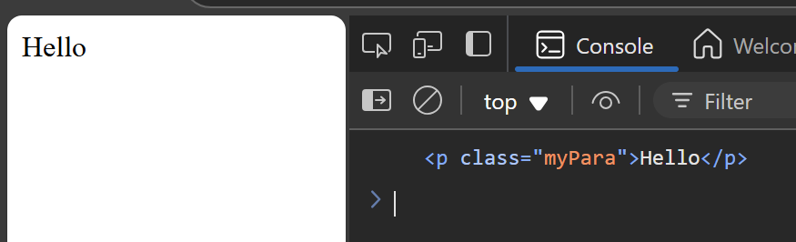
querySelector
document.querySelector('selector’)
Explain selecting a single element using CSS selectors (more powerful).
method returns the first element that matches a CSS selector.
To return all matches, use the querySelectorAll() instead.
// HTML:
<html><body><div id="parent"><p class="myPara">Hello</p></div>
<script>
const myPara = document.querySelector('#parent .myPara'); console.log(myPara);
</script> </body> </html>
// Output: <p class="myPara">Hello</p>

Slide 14
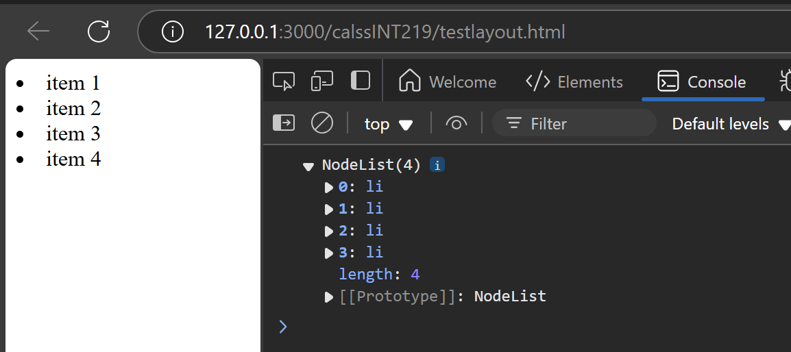
querySelectorAll
document.querySelectorAll('selector’):
Show how to select all elements that match the given CSS selector (returns a NodeList).
<html> <body>
<div class="items"> <li> item 1 </li> <li> item 2 </li> </div>
<div class="items"> <li> item 3 </li> <li> item 4 </li> </div>
<script>
const items = document.querySelectorAll('.items li');
console.log(items)
</script> </body> </html>

Slide 15
2.2 Modifying Element Content and Attributes:
Property | Description
element.innerHTML = new html content | Change the inner HTML of an element | document.getElementById("px").innerHTML = "New text!";
element.attribute = new value | Change the attribute value of an HTML element | document.getElementById("myImage").src = "2.jpg";
element.style.property = new style | Change the style of an HTML element | document.getElementById("myDiv").style.backgroundColor = "lightgreen";
Method | Description
element.setAttribute(attribute, value) | Change the attribute value of an HTML element | document.getElementById("myImage").setAttribute("src", "2.jpg");

Slide 16
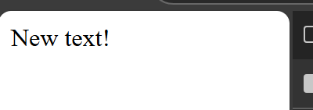
2.2.1 getElementById
<html> <body>
<p id="px">Hello World!</p>
<script>
document.getElementById("px").innerHTML = "New text!";
</script>
</body> </html>

Slide 17
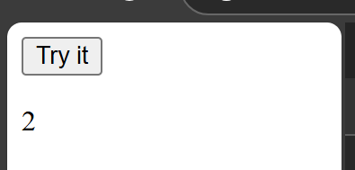
attributes.length
<html> <body>
<button id="myButton" onclick="myFunction()">Try it</button>
<p id="demo"></p>
<script> function myFunction() {
let n = document.getElementById("myButton").attributes.length;
document.getElementById("demo").innerHTML = n;
}</script> </body> </html>

Slide 18

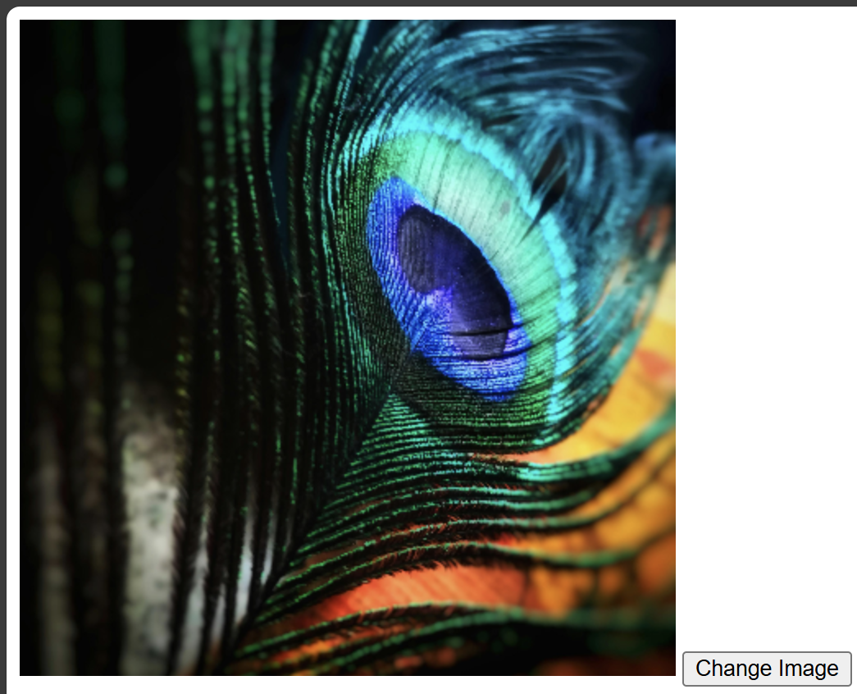
Change the attribute
<!DOCTYPE html> <html> <body>
<img id="myImage" src="1.jpg" alt="Placeholder Image">
<button onclick="changeImage()">Change Image</button>
</body> <script>
function changeImage() {
document.getElementById("myImage").src = "2.jpg";
} </script>
</html>

Slide 19
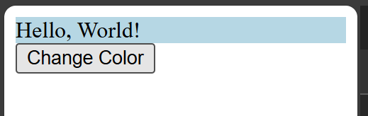
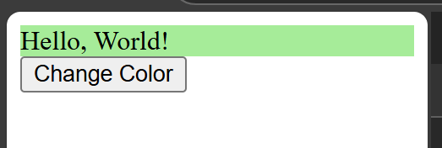
Change the style
<!DOCTYPE html> <html> <body>
<div id="myDiv" style="background-color:lightblue;">Hello, World!</div>
<button onclick="changeColor()">Change Color</button>
</body>
<script>
function changeColor() {
document.getElementById("myDiv").style.backgroundColor = "lightgreen";
}
</script> </html>

Slide 20
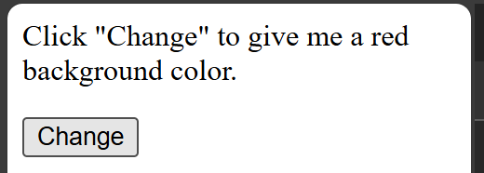
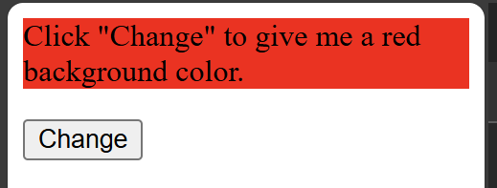
2.2.2 element.style.property
<html> <body>
<p id="xyz">Click "Change" to give me a red background color.</p>
<button onclick="myFunction()">Change</button>
<script>
function myFunction() {
document.getElementById("xyz").style.backgroundColor = "red";
} </script>
</body> </html>

Slide 21
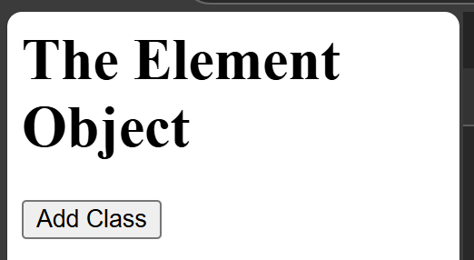
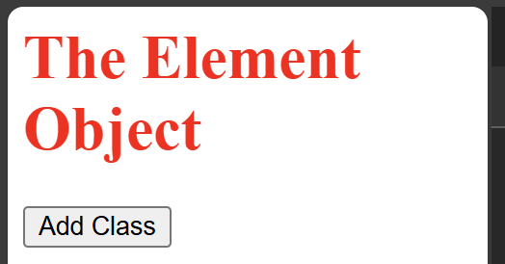
2.2.3 element.setAttribute (attribute, value)
<html>
<style> .democlass { color: red; } </style>
<body>
<h1 id="xx">The Element Object</h1>
<button onclick="myFunction()">Add Class</button>
<script> function myFunction() {
document.getElementById("xx").setAttribute("class", "democlass");
} </script> </body> </html>

Slide 22
2.3 Adding and Deleting Elements
Method | Description
document.createElement(element) | Create an HTML element
document.removeChild(element) | Remove an HTML element
document.appendChild(element) | Add an HTML element
document.replaceChild(new, old) | Replace an HTML element
document.write(text) | Write into the HTML output stream

Slide 23
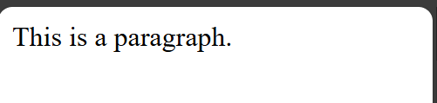
2.3.1 document.createElement(element)
<html> <body>
<script>
const para = document.createElement("p");
para.innerText = "This is a paragraph.";
// Append to body:
document.body.appendChild(para);
</script>
</body> </html>

Slide 24
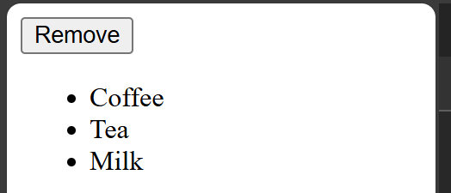
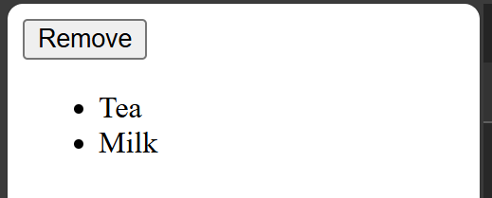
2.3.2 document.removeChild(element)
<html> <body> <button onclick="myFunction()">Remove</button>
<ul id="myList"> <li>Coffee</li> <li>Tea</li> <li>Milk</li> </ul>
<script>
function myFunction()
{
const list = document.getElementById("myList");
list.removeChild(list.firstElementChild);
}
</script> </body> </html>

Slide 25
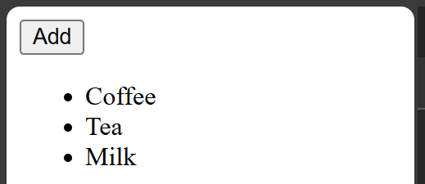
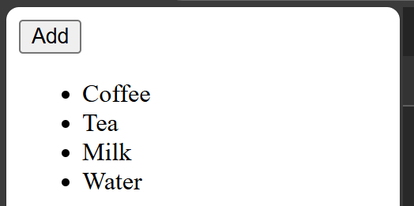
2.3.3 document.appendChild(element)
<html> <body> <button onclick="myFunction()">Add</button>
<ul id="myList"> <li>Coffee</li> <li>Tea</li> <li>Milk</li></ul>
<script>
function myFunction() {
const node = document.createElement("li"); // Create an "li" node:
const textnode = document.createTextNode("Water"); //// Create a text node:
node.appendChild(textnode); // Append the text node to the "li" node:
document.getElementById("myList").appendChild(node);// Append "li" node to list:
}
</script>
</body> </html>

Slide 26
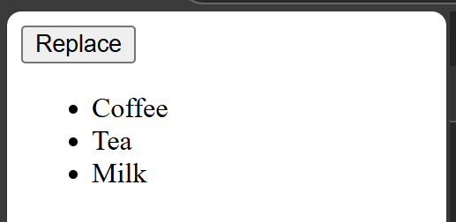
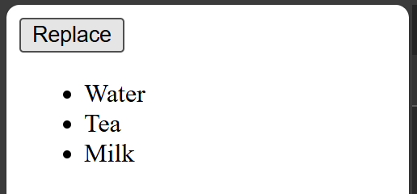
2.3.4 document.replaceChild(new, old)
<html> <body> <button onclick="myFunction()">Replace</button>
<ul id="myList"> <li>Coffee</li> <li>Tea</li> <li>Milk</li> </ul>
<script> function myFunction() {
const element = document.getElementById("myList").children[0];// Select 1st child
const newNode = document.createTextNode("Water"); // Create a new text node:
element.replaceChild(newNode, element.childNodes[0]); // Replace the text node:
}
</script>
</body> </html>

Slide 27
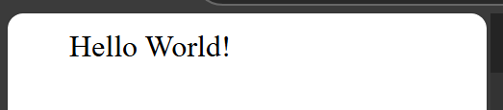
2.3.5 document.write(text)
<html>
<body>
<script>
document.write("Hello World!");
</script>
</body>
</html>

Slide 28
3. Assigning event handlers in JavaScript using DOM object property
There are primarily three ways to assign event handlers to HTML elements:
1. HTML Event Attributes
2. DOM Properties
3. addEventListener() Method

Slide 29
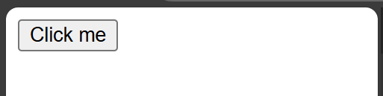
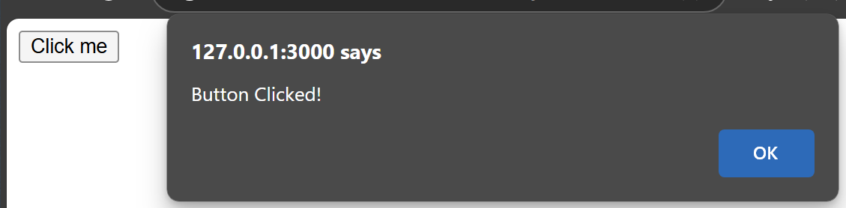
3.1 HTML Event Attributes
<button onclick="myFunction()">Click me</button>
<script>
function myFunction() { alert('Button Clicked!'); }
</script>
Simple approach
Discouraged for maintainability reasons.
It mixes HTML structure with JavaScript logic.
Maks code harder to read and debug.

Slide 30
3.2 DOM Properties
<button id="myButton">Click me</button>
<script>
const button = document.getElementById('myButton');
button.onclick = function()
{ alert('Button Clicked!'); };
</script>
This approach separates HTML and JavaScript to some extent.
Improving code organization.
It only allows assigning one handler per event type.
If you assign another event handler to the same onclick property, the previous one will be overwritten.

Slide 31
3.3 addEventListener() Method
<button id="myButton">Click me</button>
<script>
const button = document.getElementById('myButton');
button.addEventListener
('click',
function()
{ alert('Button Clicked!'); }
);</script>

Slide 32
3.3 (a) Key advantages of addEventListener():
Multiple handlers: Allows attaching multiple event handlers.
Removability: Enables removing specific event listeners using removeEventListener().
Works with any DOM object:
Can be used not only with HTML elements,
but also with other DOM objects
such as the window object.

Slide 33
multiple event listeners
<html> <body> <button id="myButton">Click me</button> <script>
const button = document.getElementById('myButton');
function firstHandler() { console.log('First handler: Button clicked’); }
function secondHandler() { console.log('Second handler: Another action on click’); }
button.addEventListener('click', firstHandler); button.addEventListener('click', secondHandler);
//Later, you can remove a specific listener if needed //button.removeEventListener('click', firstHandler);
</script> </body> </html>
Both firstHandler and secondHandler will be executed.
This method is recommended for its flexibility, control, and better code organization.
It is considered a best practice for modern JavaScript development.

Slide 34
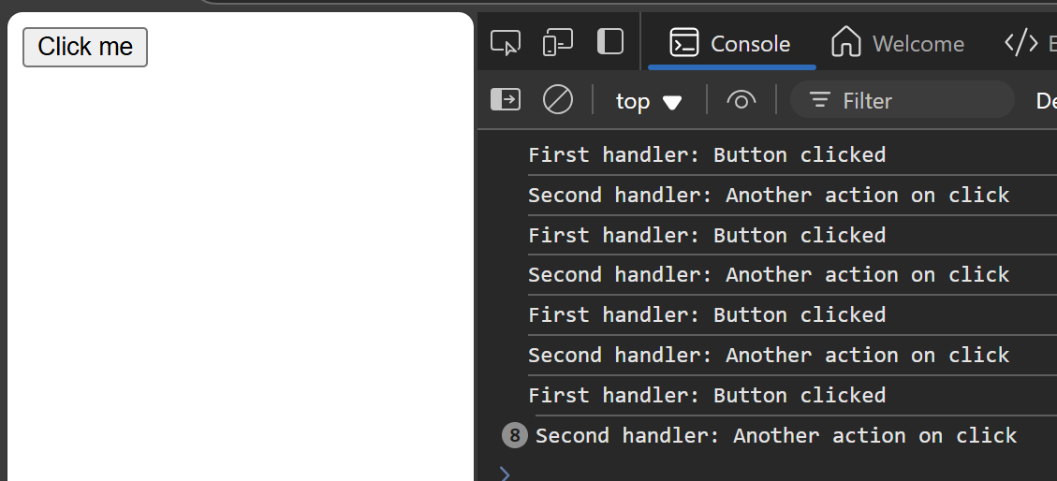
removeEventListener
<html> <body> <button id="myButton">Click me</button> <script>
const button = document.getElementById('myButton’); cnt=0;
function firstHandler() {
cnt++; console.log('First handler: Button clicked');
if (cnt>3) button.removeEventListener('click', firstHandler);
} //Later, you can remove a specific listener if needed
function secondHandler() {console.log('Second handler: Another action on click'); }
button.addEventListener('click', firstHandler);
button.addEventListener('click', secondHandler); </script> </body> </html>

Slide 35
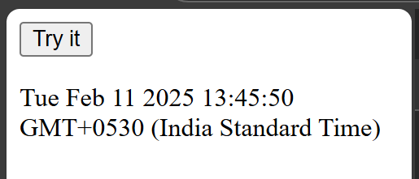
addEventListener demo2
<html> <body>
<button id="myBtn">Try it</button> <p id="demo"></p>
<script>
document.getElementById("myBtn").addEventListener("click", displayDate);
function displayDate() {
document.getElementById("demo").innerHTML = Date();
}
</script> </body> </html>

Slide 36
4. addeventlistener and removeeventlistener in JavaScript
<html> <body> <button id="myBtn">Try it</button>
<script>
document.getElementById("myBtn").addEventListener("click", function() {
alert("Hello World!");
});
</script> </body> </html>

Slide 37
addEventListener() method
It attaches an event handler to the specified element.
It attaches an event handler to an element without overwriting existing event handlers.
Add many event handlers to one element.
Can add event listeners to any DOM object.
Can easily remove an event listener by using the removeEventListener() method.

Slide 38
removeEventListener
<html> <style>#myDIV { background-color: coral; padding: 16px; }</style> <body>
<div id="myDIV">This orange element.<button onclick="removeHandler()">Remove</button> </div>
<p id="demo"></p> <script>
const myDiv = document.getElementById("myDIV");
myDiv.addEventListener("mousemove", myFunction);
function myFunction() { document.getElementById("demo").innerHTML = Math.random(); }
function removeHandler() { myDiv.removeEventListener("mousemove", myFunction); }
</script> </body> </html>

Slide 39
5. Event bubbling in JavaScript
<html> <body> <div id="parent">
<button><h2>Parent</h2></button> <button id="child"> <p>Child</p></button>
</div> <script>
document.getElementById("child").addEventListener
("click", function () { alert("You clicked the Child element!");}, false);
document.getElementById("parent").addEventListener
("click", function () { alert("You clicked the parent element!");}, false);
</script> </body> </html>
When the “Child” button is clicked:
Both the child and parent event listeners are triggered,
Event bubbling causes the event to propagate up the DOM hierarchy.

Slide 40
Event bubbling in JavaScript
It is a way that events
move through the elements in an HTML document.
When an event happens in a specific element,
it first affects that element and then moves up to its parent elements,
triggering any event listeners attached to those parents.
This process is called “bubbling” because it starts at the bottom
(the innermost element) and bubbles up to the top (the outer elements).

Slide 41
How Event Bubbling Works
Starting Point: The event starts with that element. (clicking a button)
Propagation: The event then moves up through its parent elements in the DOM tree, triggering any event listeners that are set up for that event type.
Order of Execution: The innermost element’s event listener is executed first, followed by the outer elements in the order they appear in the DOM.

Slide 42
<html> <body> <div id="parent">
<button><h2>Parent</h2></button> <button id="child"><p>Child</p></button> </div>
<script>
document.getElementById("child").addEventListener("click", function () {
alert("You clicked the Child element!");event.stopPropagation();}, false);
document.getElementById("parent").addEventListener("click", function () {
alert("You clicked the parent element!");}, false);
</script> </body> </html>

Slide 43
6. Image gallery with thumbnails in JavaScript
<html> <body> <h1>Simple Image Gallery</h1>
<img id="main-image" src="1.jpg" alt="Main Display" width="400">
<div><img class="thumbnail" src="1.jpg" alt="Thumbnail 1" width="80">
<img class="thumbnail" src="2.jpg" alt="Thumbnail 2" width="80"></div>
<script>
const mainImage = document.getElementById("main-image");
const thumbnails = document.querySelectorAll(".thumbnail");
thumbnails.forEach((thumbnail) =>
{thumbnail.addEventListener("click", () => { mainImage.src = thumbnail.src; }); });
</script> </body> </html>

Slide 44


